Slide 1

Flight Delay Analysis
Business Intelligence & Data Warehousing
Group 4- Vishal, Kesha, Sankalp and Shivam

Slide 2

Flight Delay Analysis
Agenda
Business Scenario
Swim Lane Diagram
Architecture Diagram
Data Model
ETL Design Overview
ETL Mapping
Tableau Dashboard

Slide 3
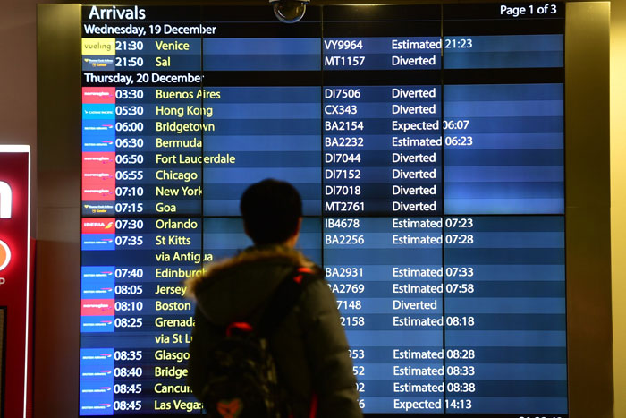
Business Scenario
Descriptive Analysis
Airport
Airlines
Cancelation of flights
Arrival and departure delays.
Notes:
As a manager or different airports in the United States, the different challenges faced by manager include identification and resolution of various aspects for flight delays, and also the performance analysis from an airport to a specific destination. There are also many flights that get diverted due to air traffic or are cancelled due to multiple reasons which affect the performance of the airport and causes chaos, analyzing the data can aid in reducing if not removing such scenarios.

Slide 4
Data Exploration
Dataset contained more than 1 million rows and 50 columns. We trimmed the dataset to keep relevant columns required for the analysis.
Schedule
Flight id, Date, Airline Code, Origin, Destination, Scheduled Arrival, Scheduled Departure, Diverted, Cancelled.
Delay
Flight id, wheels On, wheels Off, Departure Time, Arrival Time
Airports
Airport Code, Airport Name, City, County, State
Airline
Airline Code, Airline Name

Slide 5
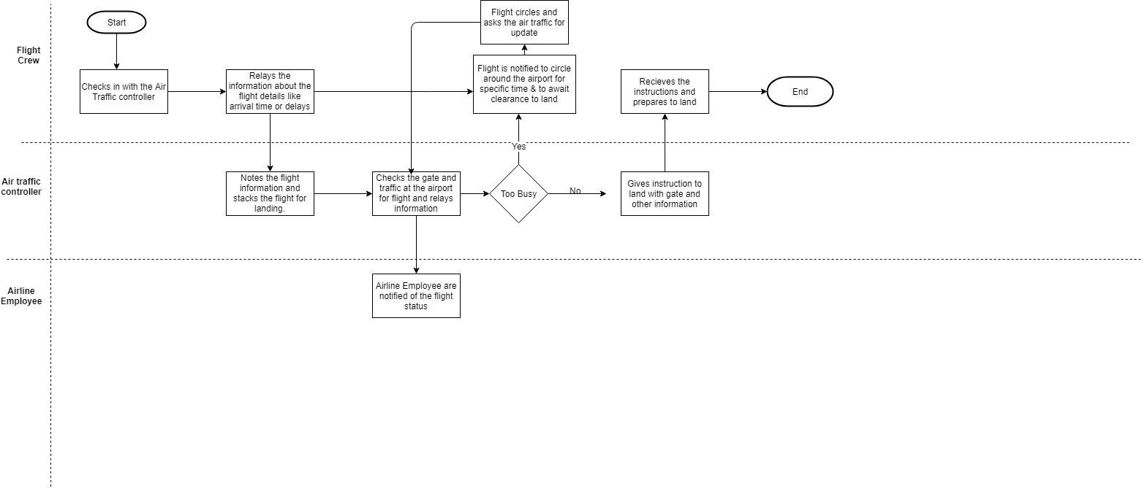
Swim Lane Diagram

Slide 6
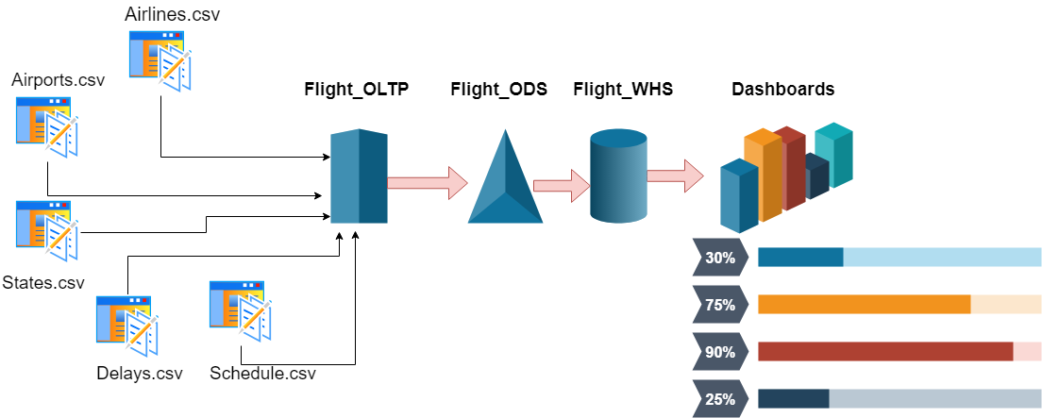
Data Architecture
Notes:
This is the architecture for our project We take various inputs in form of csv files and combine them together in oltp further taking data to ods and warehouse to present visualization in dashboards

Slide 7
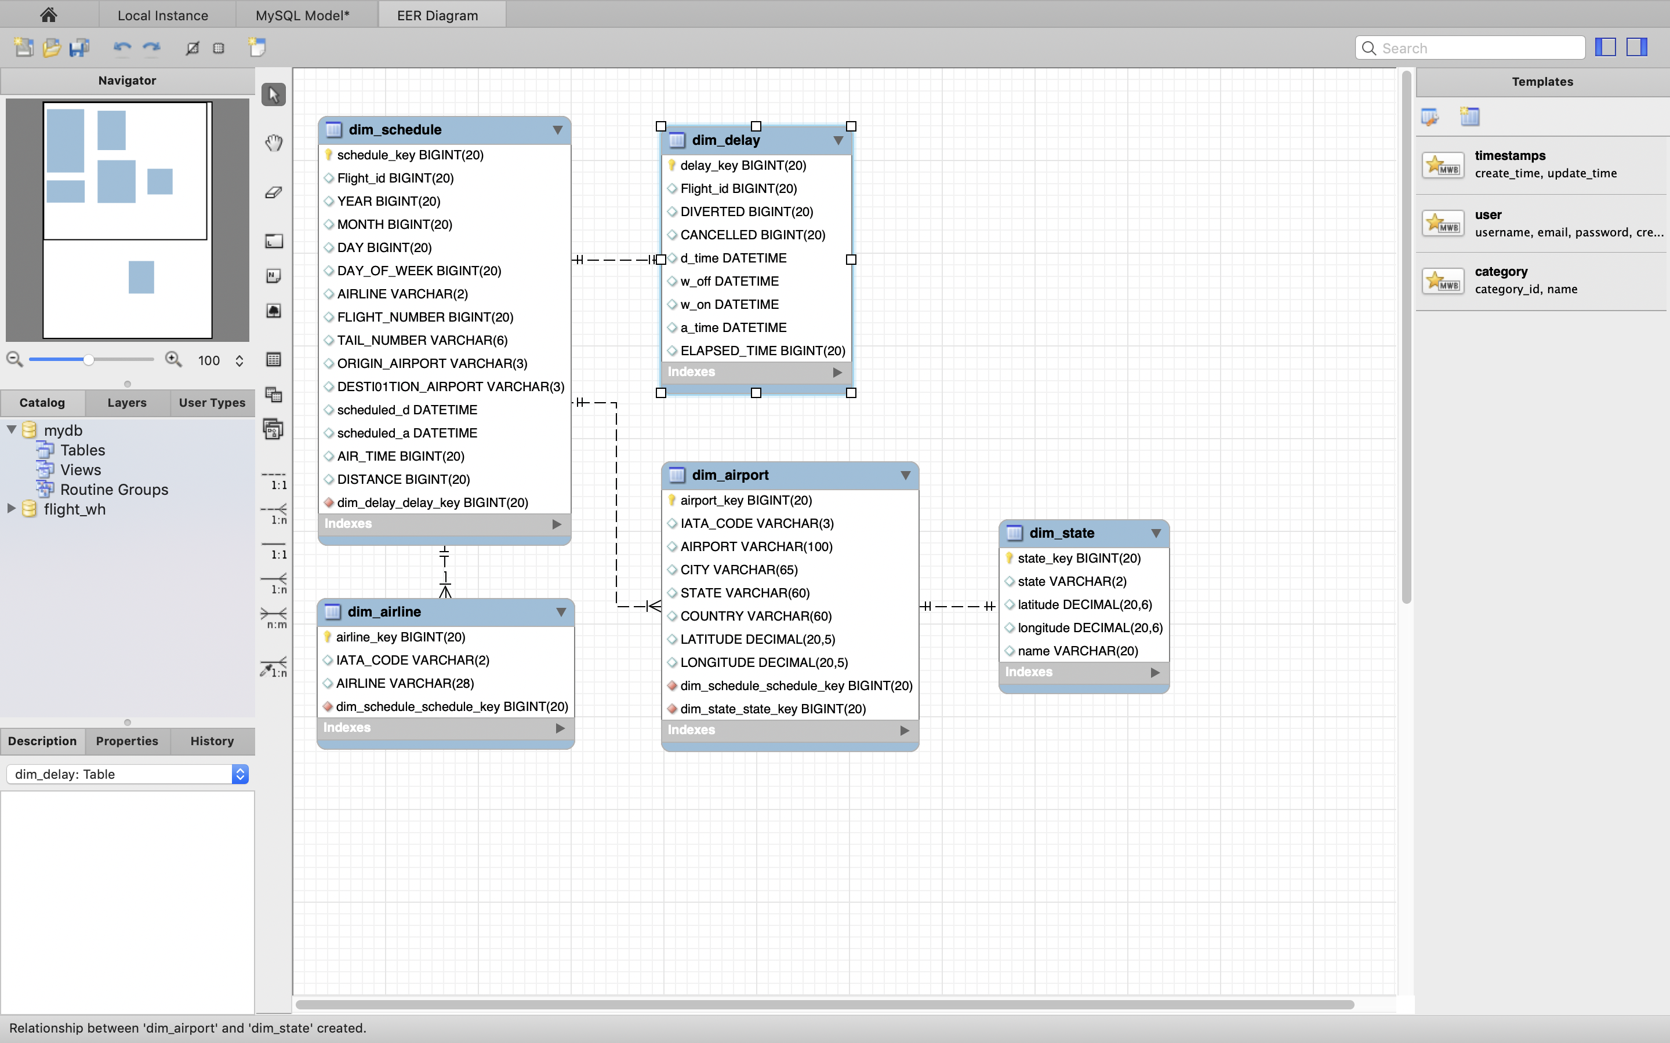
Data Model
Notes:
This is our schema for data base

Slide 8
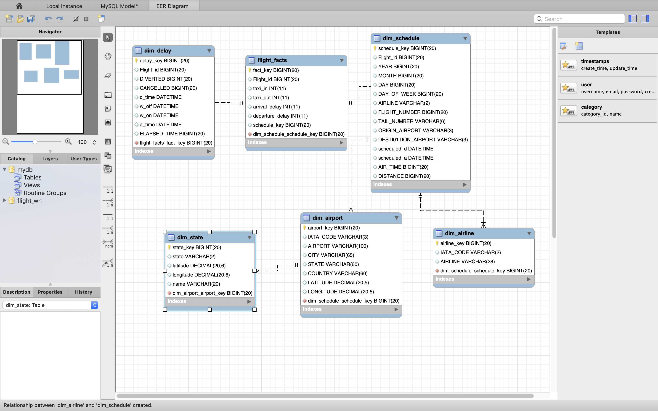
Data Warehouse
Notes:
This is our warehouse schema where we combine various dimension tables to one fact table calculating
Taxi out is the amount of time it takes from gate to actual take off whereas taxi in is just the reverse of that
arrival delay= scheduled arrival - actual arrival
dep delay

Slide 9
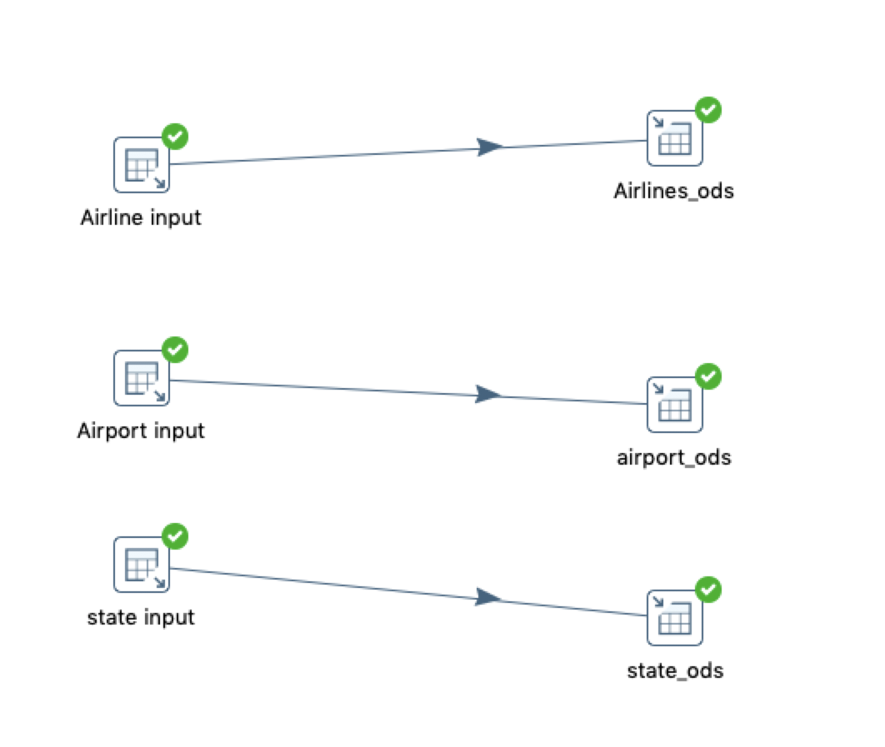
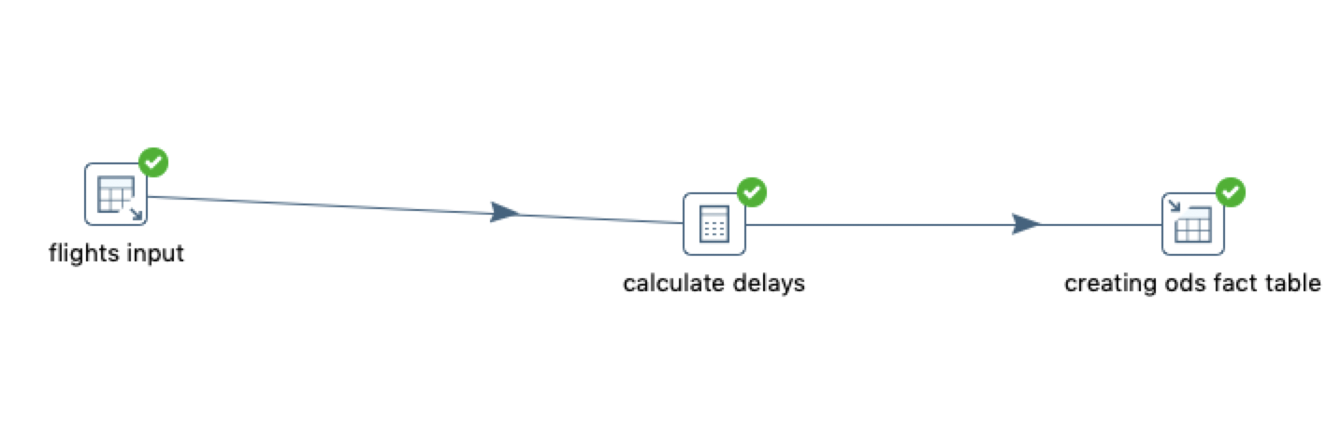
ETL Mapping
Designed an ODS database by importing all flight tables
Extracted only essential attributes required to create the dimension table.
Calculated
arrival delay
departure delay
taxi in
taxi out
to generate fact table in ODS.
Notes:
Screenshots of etl
Designed an ods importing all flight tables extracting only essential attributes further we calculate to generate fact table in ods

Slide 10
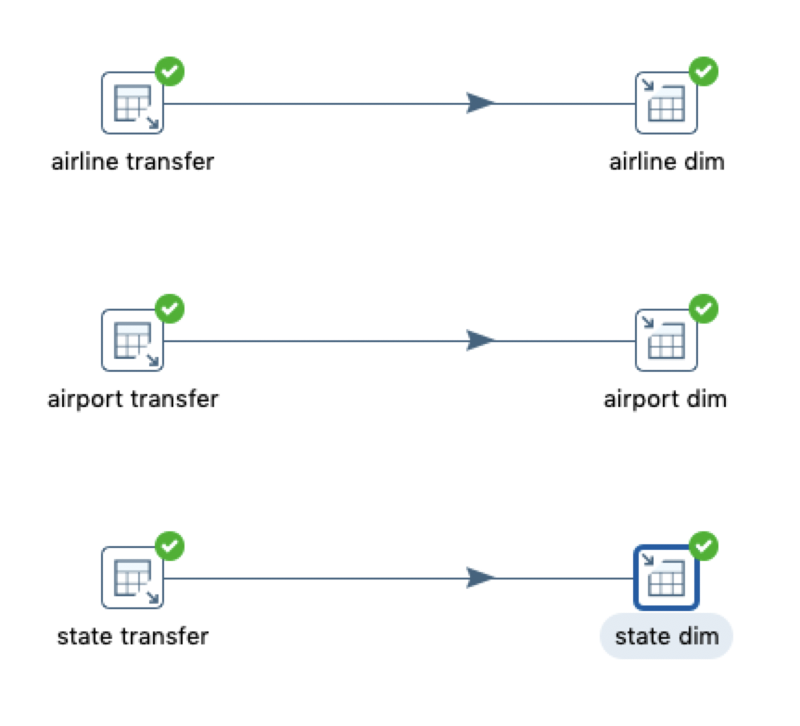
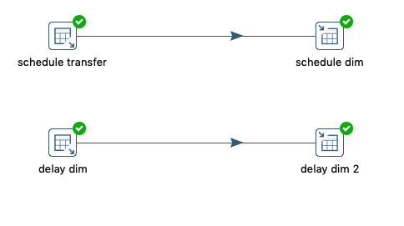
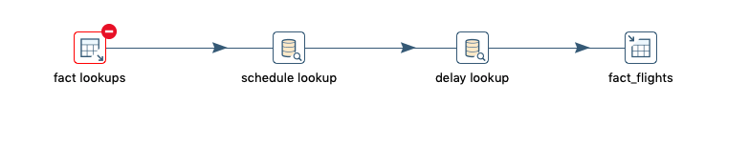
ETL Mapping
Designed a Data Warehouse to load the dimension tables from the ODS database.
Created a fact table with schedule,delay lookups inside the Warehouse.
Notes:
Based on warehouse schema we load dimension tables from ods and create a fact table with schedule and delay lookups

Slide 11
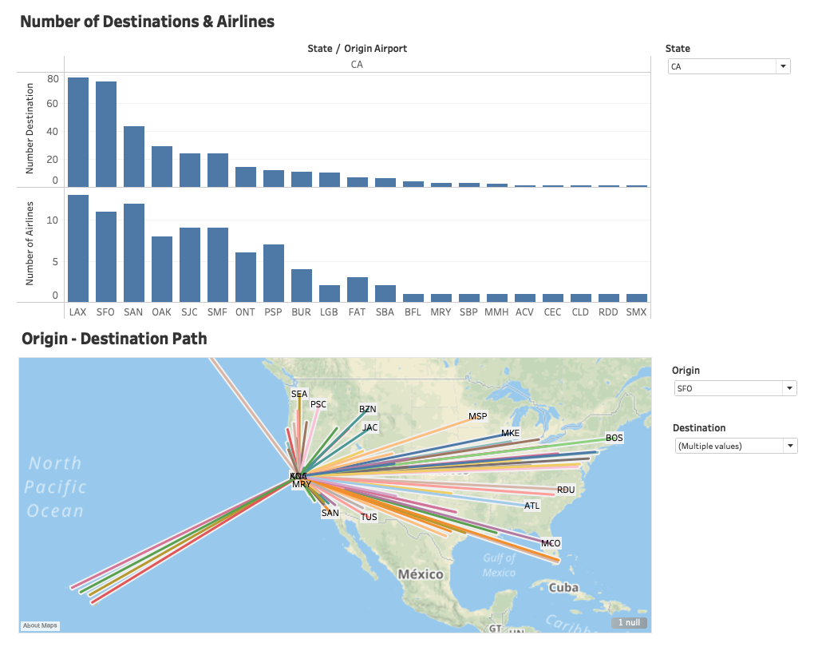
Airport Connectivity
Notes:
We have multiple parameters that can be used for analysis. We have divided them into airports and airlines
The first one here starts with the airport.
This dashboards shows us the number of airlines flying from a particular airport and the total number of unique destinations they fly to.
When we select a particular State, this graph shows the total airlines and destinations for all the airports in that state.
Further when we click on the particular airport we can see the connectivity in the map below changes to show all the path from origin to destination.

Slide 12
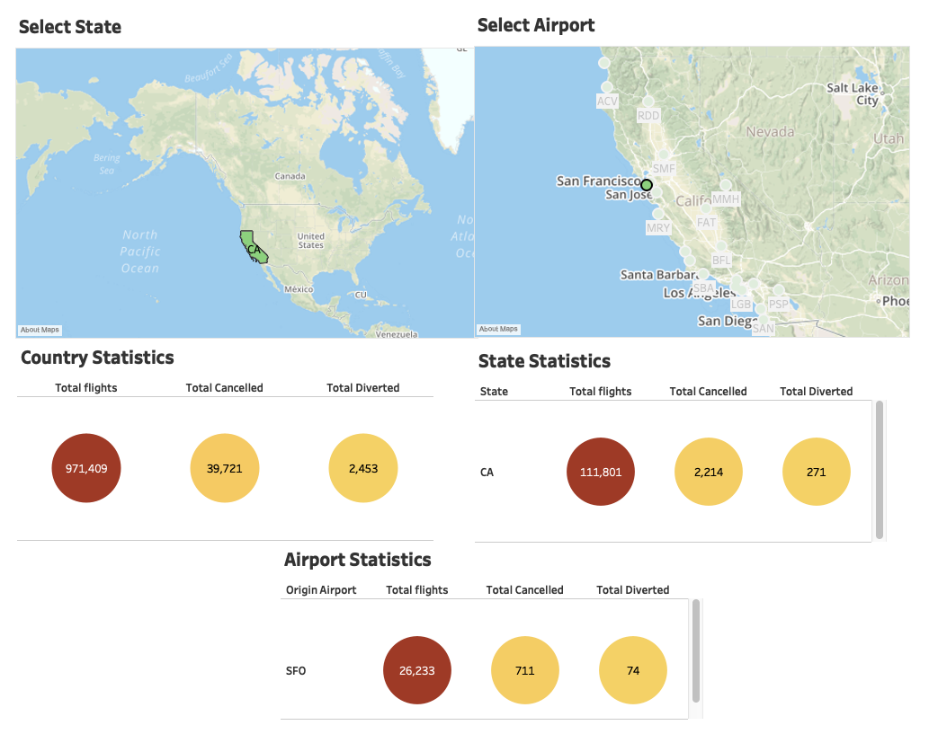
Airport Statistics
Notes:
This Dashboard shows us the comparison between total flights, cancellations and diversions from a particular airport.
Upon selection of the state and the airport from the 2 maps the airport manager can then compare his/her airport’s stats to that of the country and state.

Slide 13
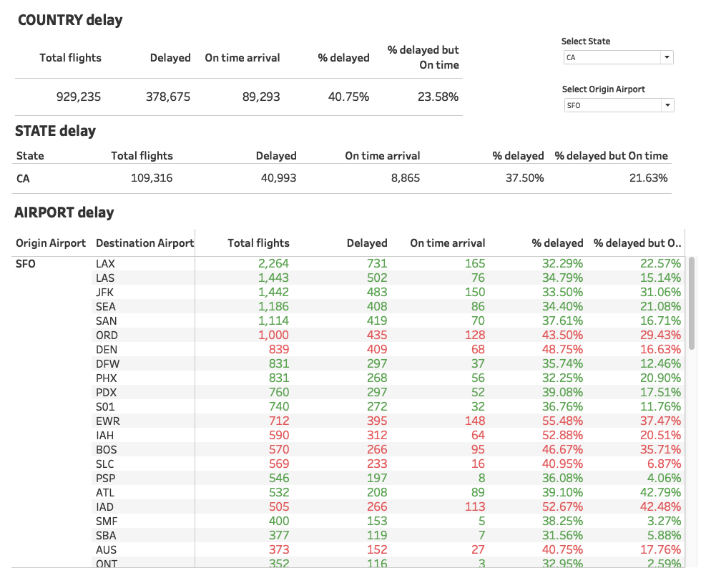
Performance Analysis
Notes:
This dashboard shows the total and delayed flights for the country, state and origin airport.
It displays the % of flights delayed in a particular route and the last column shows the flights that arrived on or before scheduled arrival time even though they were delayed at the origin airport.
Here as well the manager can compare the stats of their airport to that of the state and country.
He can also compare the stats for different destinations from the same airport.
The color coding in the table represents the average compared to the country average. Red means above and green means below.

Slide 14
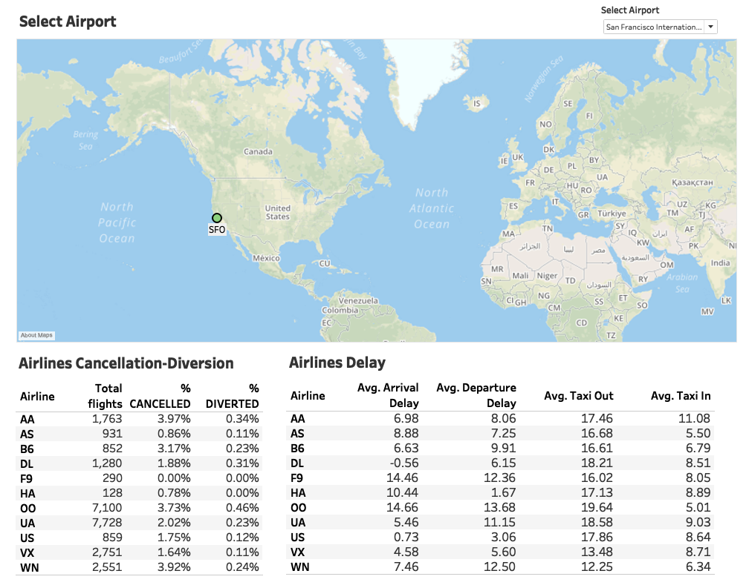
Airline Statistics
Notes:
Coming to the Airlines. This dashboard shows the % of cancelled and diverted flights for each airline from the selected origin airport.
It also shows the arrival and departure delays and the taxi-in and taxi-out times.
As we can see, for OO that is the Skywest Airline, the Arrival and Departure delays are the highest along with the taxi out time and when we look at cancellations and diversions it stands in the top 3 highest %. So try not to book this flight from SFO.

Slide 15
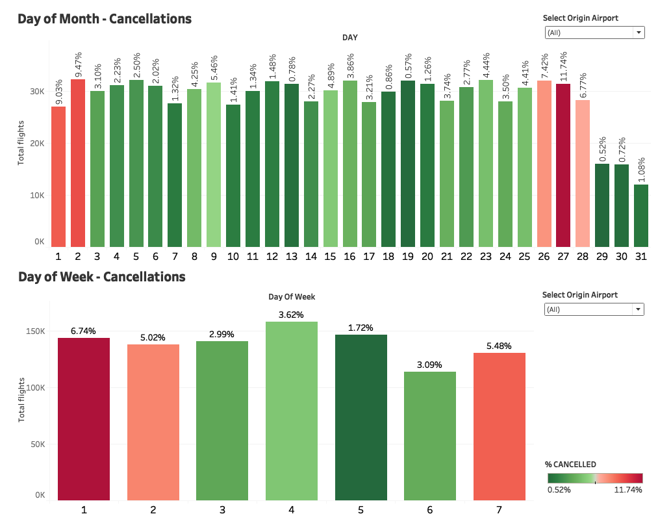
Cancelation Insight
Notes:
Coming to the Monthly and Daily analysis. The dashboard indicates the % of cancelled flights for each day and per day of the week.
The lowest to highest is colored from green to red, red being the highest % of cancellations.
As we can see, there are highest cancellations in the beginning and the end of the month.
For days of the week, Thursday has the highest number of flights scheduled and the maximum cancellations ar eon Sunday and Monday.
We can also apply filter and look for each airport.

Slide 16
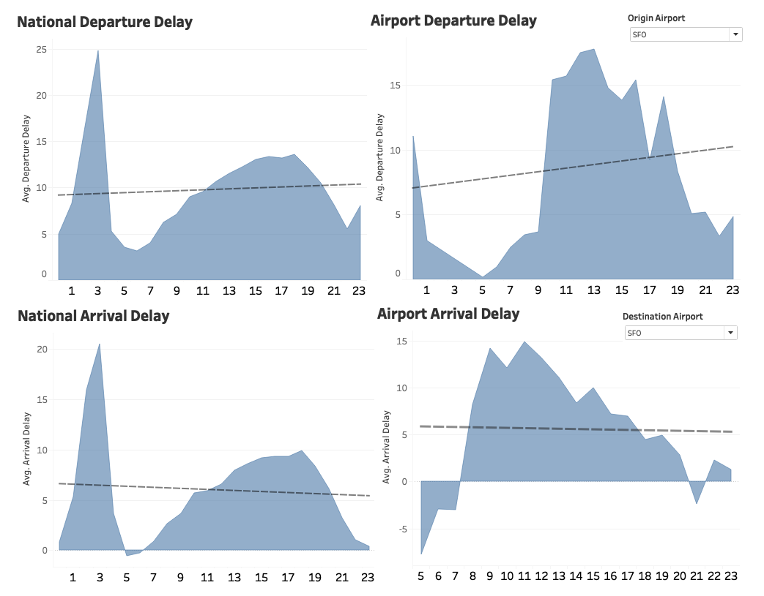
Departure Delay Insight
Notes:
This dashboard shows the departure and arrival delays for nationwide as well as the selected airport during different time of the day in 24hr format.
Here we can see that for sfo the departure delay is the lowest during the morning and has a steep increase at 9am.
And for arrival delay the flights reach before scheduled arrival until around 9 and then has a steep increase during the day.
The manager of the airport can compare it with the national average.

Slide 17

THANK YOU

